Slide 1
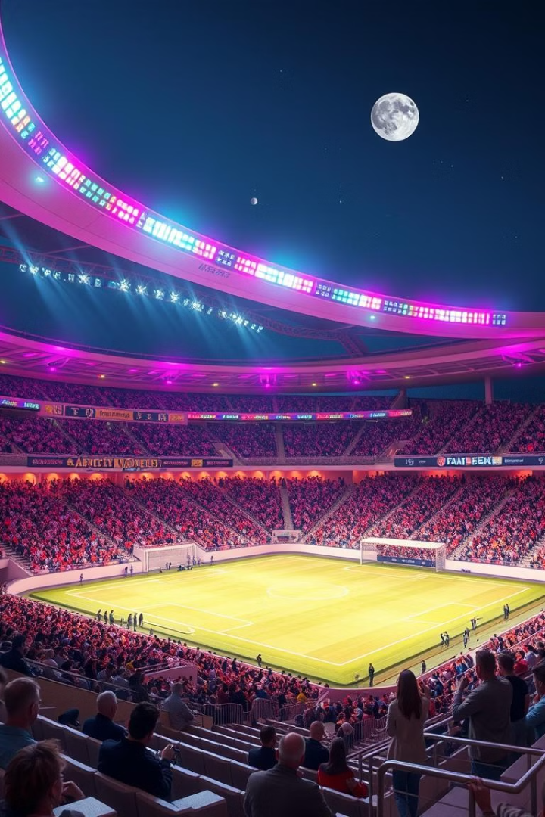

Revolutionizing Stadium Ticket Booking
The stadium ticket booking experience is ripe for innovation. Traditional systems are often plagued by long queues, scalping, and confusing interfaces. This creates a frustrating experience for fans and missed revenue opportunities for stadiums.
by PSREC 22CS068

Slide 2
The Pain Points: What's Wrong with the Current System?
Long Queues
Scalping & Fraud
Fans often face long waits in line to purchase tickets, detracting from their game day experience.
Ticket scalping and fraud are rampant, leading to inflated prices and a lack of trust for fans.

Slide 3
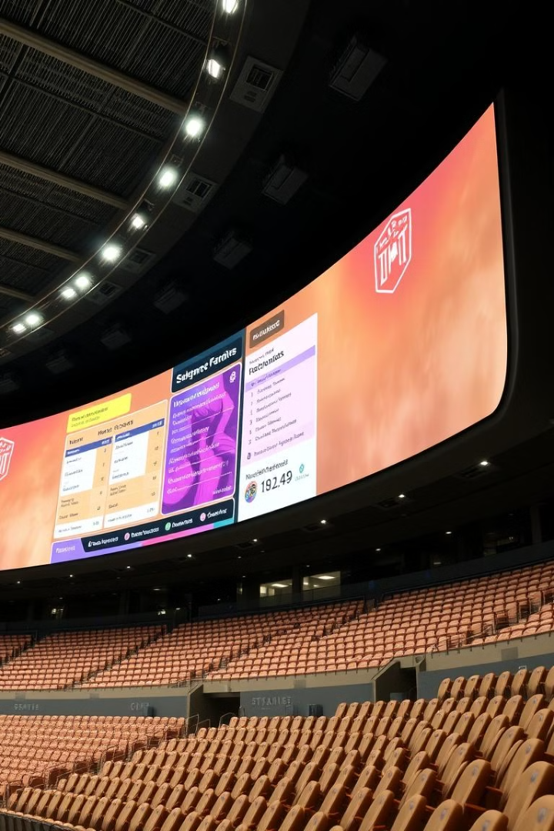
Introducing [Your Company Name]: The Future of Stadium Ticketing
1
AI-Powered Pricing
Dynamically adjust prices based on factors like demand, opponent, and player performance, maximizing revenue for stadiums.
2
Secure Blockchain Transactions
Leverage blockchain technology to eliminate fraud and scalping, ensuring genuine tickets for fans.

Slide 4
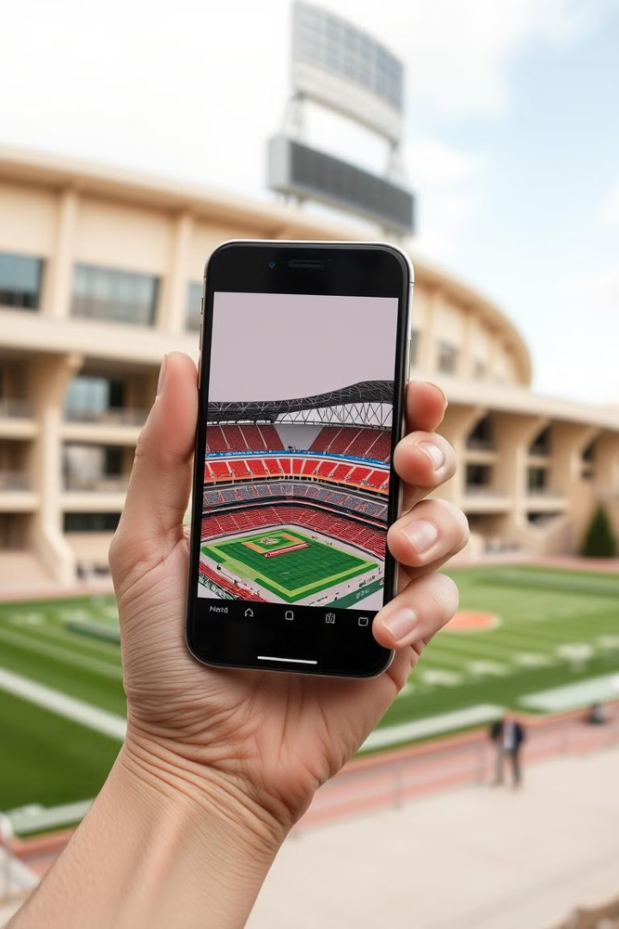




Key Features: A Deep Dive
Dynamic Pricing
Blockchain Security
Interactive Seat Maps
AI-powered pricing algorithms adjust ticket prices in real-time based on factors like demand and opponent, maximizing revenue for stadiums.
Blockchain-secured tickets eliminate the possibility of fraud and scalping, ensuring authentic and secure transactions.
Fans can explore a 3D interactive seat map, viewing stadium perspectives from each seat to make informed decisions.
Personalized Recommendations
Fans receive customized recommendations based on their preferences, ensuring they don't miss out on their favorite teams and events.

Slide 5

Benefits for Stadiums & Teams
Increased Revenue
Enhanced Fan Loyalty
Dynamic pricing strategies optimize ticket sales, maximizing revenue and profitability for stadiums.
Personalized experiences and exclusive offers foster a stronger sense of community and loyalty among fans.
Reduced Operational Costs
Automation and streamlined processes minimize manual labor, reducing operational costs and freeing up resources for other areas.

Slide 6

Benefits for Fans
Seamless Experience
A user-friendly platform simplifies ticket purchase and management, offering a streamlined experience.
Secure Tickets
Fans are confident knowing their tickets are protected from fraud and scalping, thanks to blockchain security.
Personalized Offers
Fans receive tailored recommendations and exclusive offers based on their interests and preferences.
Enhanced Game Day
Interactive seat maps and digital ticketing provide a seamless and immersive game-day experience.

Slide 7
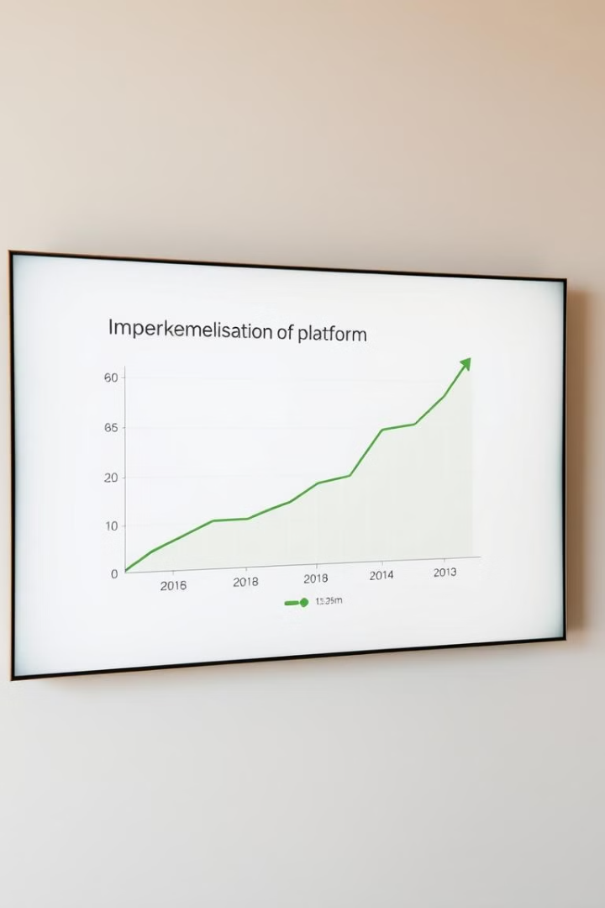
Case Study: Early Success
1
Increased Ticket Sales
We have seen a significant increase in ticket sales since implementing our platform.
2
Improved Customer Satisfaction
Fans are delighted with the ease of use, security, and personalization offered by our platform.
3
Reduced Fraud
The blockchain technology has effectively eliminated fraud, creating a secure and trustworthy environment for fans.

Slide 8
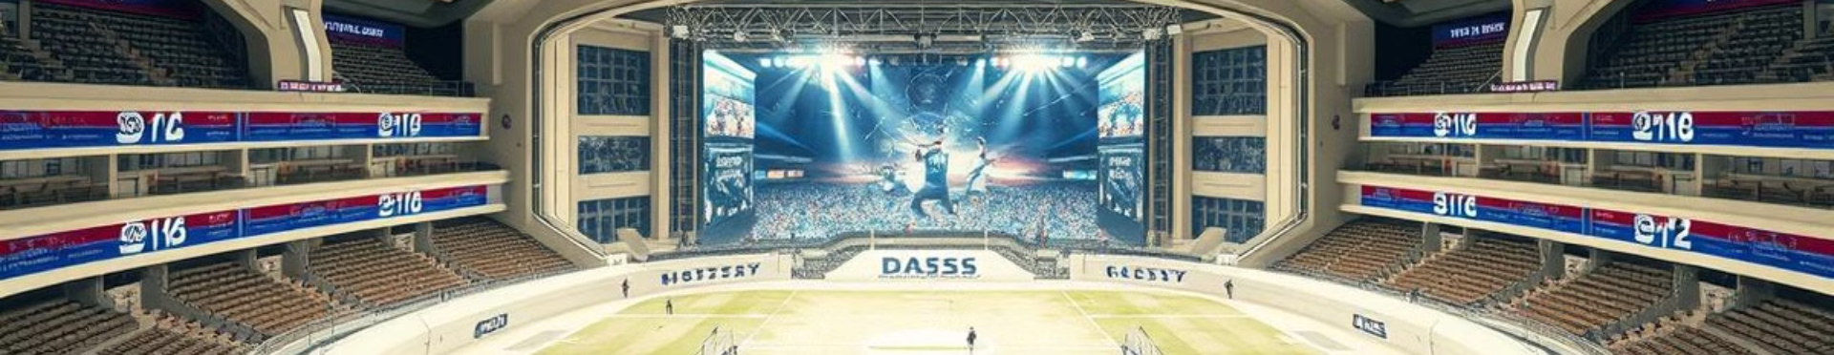
The Future of Stadium Ticketing is Here
Partner with [Your Company Name] to revolutionize your stadium ticketing experience. We offer a solution that benefits everyone: enhanced fan experiences, increased revenue for stadiums, and a future-proof ticketing infrastructure. Contact us today to learn more.

